Slide 1
A CASE STUDY IN BANKRUPTCY PREDICTION
GARY KULECK

Slide 2
EXECUTIVE SUMMARY (ABSTRACT)
Company bankruptcy is of great concern worldwide.
The capacity to predict potential bankruptcy is sought by many concerned players: financial institutions, government agencies, investors amongst others.
Working with Polish manufacturing company data available at:https://archive.ics.uci.edu/ml/datasets/Polish+companies+bankruptcy+data#
This study (using the R programming language) examines the basic structure of the dataset and
Attempts to create models that can efficiently predict bankruptcy.

Slide 3
Outline of the Study
Detailed analysis of the Data Set
Logistic Regression Modeling
Random Forest Modeling
Extreme Gradient Boosting Modeling
Summary of Findings and Industry Implications

Slide 4
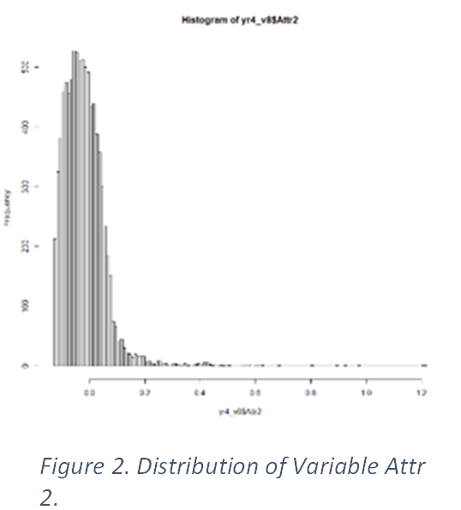
Data Set Analysis I.
Initial Dataset: 64 variables(63 continuous, 1 categorical). Imbalanced dataset(~95% non-bankrupters; ~5% bankrupters)
DATA PREPARATION
Contains many missing values(corrected by eliminating problematic observations(outliers) and removing highly correlated variables);
1/3 of missing values replaced by median for a variable.
Final data set: 9,655 observations; 39 predictor variables;
1 target variable(bankruptcy: yes or no).
Question 1: Are the variables in the dataset normally distributed?(important for considering how to model).
Performed Kolmogrov-Smirnov test
Answer: None of the variables are normally distributed.

Slide 5
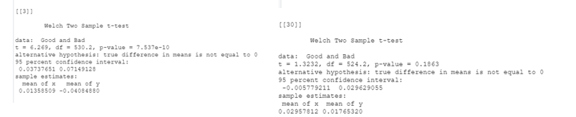
Data Analysis II.
Comparison of bankrupters to non-bankrupters
Do any of the variables differ in these 2 populations in terms of distribution?
Performed Welch t-test(parametric); Mann-Whitney U test(non-parametric
Welch t-test: 16 variables showed differences in 2 populations
Discussion: Will any of
these variables show up
in models? Yes!

Slide 6
Goals in modeling
Want
Want to identify bankrupters(B)- paramount AND
Maintain
maintain overall accuracy – balance with keeping misidentified non-bankrupters(NB) low.
Minimize
Minimize false negatives(B’s identified as NBs) and false positives(NB’s identified as B’s)
Use
Use Youden Index maximum to set binary classification cut-off probability
Model
Model performance scoring methods(order of importance): Sensitivity, specificity, AUC-Precision Recall, Brier Score, accuracy

Slide 7
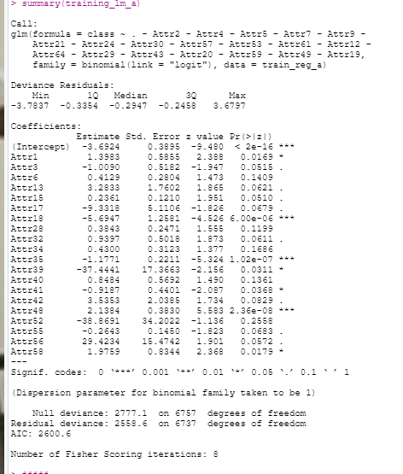
Logistic regression
Logistic regression uses logs-odds to develop models
that can predict in binary classification.
Can determine which variables contribute significantly
to a model, both in magnitude and sense of direction.
Assumes classes are linearly separable; minimal
multicollinearity; requires that independent
variables are linearly related to log-odds.
FSummary training_lm_a model

Slide 8
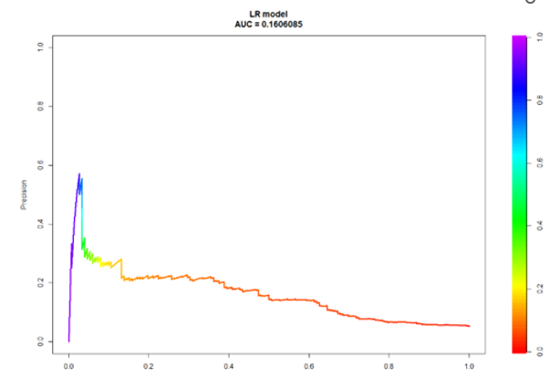
Logistic regression
Created 5 models- unmodified, ROSE(3 types), SMOTE
Evaluated with scoring criteria – sensititivity, specificity, AUC-PR, accuracy, F1 score
Unmodified dataset model performed
best
Type | Accuracy | Sensitivity | Specificity | PPV | AUC/ PR | F1-score
LR/ unmodified | 0.7863 | 0.5987 | 0.7966 | 0.1554 | 0.1606 | 0.2047

Slide 9
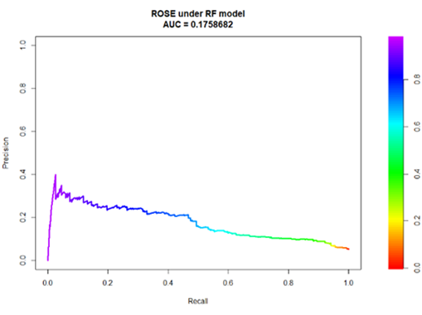
Random Forest
Ensemble of decision trees- uses bagging to development independent decision trees-aggregate votes with most frequent outcome as predicted output
May not work well with imbalanced data set
Created 5 models: Best:ROSEunder model
Type | Acc-uracy | Sensi-tivity | Specif-icity | PPV | AUC/ ROC | AUC/ PR | F1-score
LR/ Unmod-ified | 0.7863 | 0.5987 | 0.7966 | 0.1554 | 0.716 | 0.1606 | 0.2047
RF/ROSE Under/ Hyper-tuned | 0.6851 | 0.7171 | 0.6833 | 0.1115 | 0.781 | 0.176 | 0.1910

Slide 10
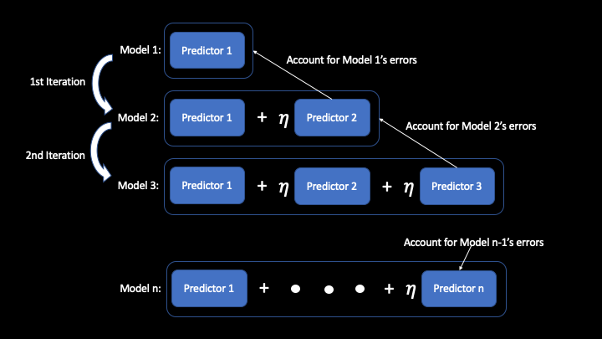
Extreme Gradient Boosting(XGB)
Combines ‘weak’ learner output to create a ‘strong’ learner function, subsequent models will favor the correct classification of cases previously misclassified. XGB builds tree branches in parallel and employs regularization to prevent overfitting.
Could still be sensitive to outliers;
black box-hard to tweak
5 models: Best: ROSE both model
https://towardsdatascience.com/the-intuition-behind-gradient-boosting-xgboost-6d5eac844920

Slide 11
Model comparison
Type | Accuracy | Sensi-tivity | Specif-icity | PPV | AUC/ ROC | AUC/ PR | F1-score | Max Youden Index/mce**
LR/ unmodified | 0.7863 | 0.5987 | 0.7966 | 0.1554 | 0.716 | 0.1606 | 0.2047 | 0.3953/ 0.2137
RF/ROSE Under/ hypertuned | 0.6851 | 0.7171 | 0.6833 | 0.1115 | 0.781 | 0.176 | 0.1910 | 0.3972/ 0.3239
ROSE both/ XGB | 0.7830 | 0.7697 | 0.8010 | 0.1637 | 0.845 | 0.350 | 0.2712 | 0.5708/ 0.2006

Slide 12

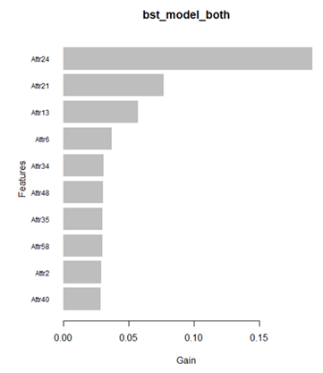
Rankings Score to find Most Important Variables in each model
LR models: Rankings(score): Attr48(40), Attr35(29), Attr18(28), Attr34(16), 3(14), 39(12).
RF models: Rankings(score): Attr24(20); Attr13(17), Attr6(17), Attr21(7)
XGB: Rankings(score): Attr24(49); Attr21(42), Attr13(41), Attr6(36), Attr48(16), Attr35(15), Attr34(14), Attr40(10), Attr58(9). Final model: bst_model_both(Most important variables(Figure 6)).
XGB model ROSE both –superior

Slide 13

XGB Model incorporates Most Important Variables from both LR and RF models
Logistic Regression
Most Important Variables(MIVs)
Attr(48,35,18,34)
Random Forest
Most Important Variables(MIVs)
Attr(24,13,6,21)
XGB
Most Important Variables (MIVs)
Attr(24,21,13,6,48,35,34)
XGB Model incorporates MIVs from both Logistic Regression and Random Forest models.
Attrs 24,21,13,6 focus on company profitability more than a year.
Attr 48, 35,34 deal with a company’s capacity to generate cash, control and payoff short-term liabilities.

Slide 14
How do identified attributes(financial ratios) align with the hallmarks of a company headed for bankruptcy?
A company is unable to generate cash flow or control liabilities to pay off liabilities due.(Attr 48, Attr 34, Attr 3)
Company cannot generate profits to grow or sustain business.(Attr13)
Profit margins are too slim or are falling.(Attr39)
Sales volume and profit margin are slipping year to year.(Attr24, Attr21)
Creditors are unwilling to extend further credit or seeking legal action to recover extended credit.
Company has no capacity to sustain growth through retained earnings(Attr 6)
Company is unable to leverage profits/assets for sales growth efficiently(Attr 35, Attr18)
The attributes identified are associated with factors which lead to company bankruptcy.

Slide 15
Summary of proposed Course of Action
Given the hallmarks of company’s risk of failure(bankruptcy), three general areas of concerns have been identified which bear scrutiny:
Monitoring a company’s financial data on profitability, growth, and sales dynamics over several years may highlight companies inclination to bankruptcy;
Monitoring a company’s cash flow and capacity to generate enough income to cover current liabilities;
Examining a company’s policies and strategies to control expenses, and effectively use assets to generate profits, triggered by thresholds in the financial ratios.
2. The financial ratios deemed to be significant should be carefully observed for any sign that the company is undergoing the types of stress that signify that its financial status as an ‘ongoing concern’ may be in jeopardy(Islam, 2020)*.
*Islam, M.S. (2020) Predictive capability of Financial Ratios for forecasting of Corporate Bankruptcy. IOSR Jrnl. Bus. And Mngmt. 22(6):13-57.

Slide 16
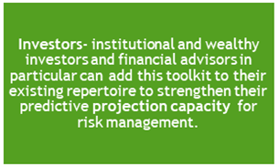
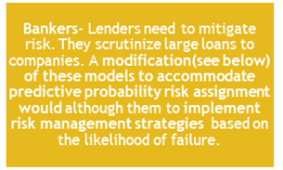
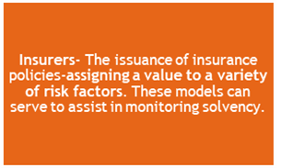
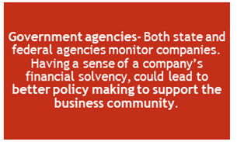
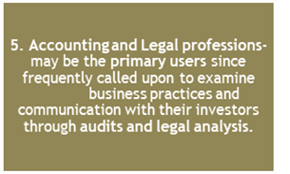
Who can benefit(and how) from this study?

Slide 17



Next steps I

Slide 18
Next steps II
Other machine learning modeling techniques
Neural Networks (NN) – variety of approaches
Support Vector Machine (SVM)

Slide 19
Next Steps III
Adding Corporate Governance Indicators(Liang et al., 2016)*
Decision Making by Board of Directors
Adherence to Legal & Regulatory Framework
Risk Assessment & Information Communication
Policies and Procedures
Transparency & Accountability
Monitoring & Internal Controls
*Liang et al.(2016) Financial ratios and corporate governance indicators in bankruptcy prediction: A comprehensive study. Eur. Jour. of Operational Res. Vol. 252: 561-572. https://isslab.csie.ncu.edu.tw/download/publications/1.Financial%20Ratios%20and%20Corporate%20Governance%20Indicators%20in%20Bankruptcy%20Prediction-A%20Comprehensive%20Study.pdf

Slide 20
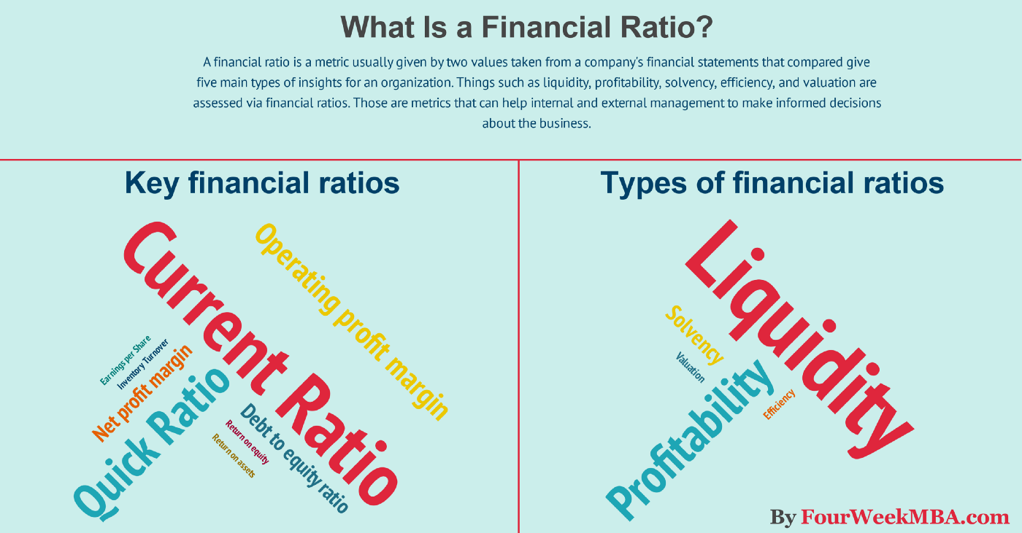
Conclusion
Null H_{o} : Company Bankruptcy cannot be predicted from a company’s financial ratios.
Alternative H_{o}: Financial Ratios can be used to predict a company’s bankruptcy.
CONCLUSION: Reject the null H_{o}. Company bankruptcy is predictable with a model based on financial ratios.

